Slide 1
Adaptability and Psychological Inflexibility: Overlapping Constructs?
Daniel Waldeck, Coventry University, UK
Luca Pancani, University of Milano-Biccoca, Italy
Andrew Holliman, University College London, UK
Maria Karekla, University of Cyprus, Cyprus
Ian Tyndall, University of Chichester, UK
Sarah Cassidy, Smithsfield Clinic/Maynooth University

Slide 2
Adaptability
The ability to adjust (or adapt) one’s behaviors in response to changing (and potentially challenging) environments is known to promote positive psychological wellbeing outcomes (Martin et al., 2013; Zhou & Lin, 2016).
According to the tripartite model (Martin et al., 2013), adaptability refers to an individual’s cognitive, behavioral, and emotional regulation (or adjustment) in situations of change, novelty, and uncertainty.
While related, it is distinct from other constructs involving emotional self-regulation resources such as resilience, coping, and buoyancy (see Martin et al., 2013, for a review).

Slide 3
Could there be an overlap with psychological inflexibility?
Psychological inflexibility - a behavioral pattern of excessive control of a person’s thoughts, feelings, and emotions, with a tendency to avoid unpleasant internal experiences at the expense of more effective or valued actions (Hayes et al., 2006)
Psychological inflexibility also a strong predictor of psychological distress and wellbeing outcomes (e.g., Bond et al., 2011)

Slide 4
Could there be an overlap with psychological inflexibility?
No research to date has directly examined the relationship between adaptability and psychological inflexibility.
Surprising considering that Hayes et al. (1996) suggested that
“one cost [of psychological inflexibility] is that a stenotopic condition - a narrow range of adaptability to changes in environmental conditions - ensues” (p. 1160).

Slide 5
Could there be an overlap with psychological inflexibility?
Both adaptability and psychological inflexibility appear distinct from more well-established self-regulatory constructs such as coping and resilience (e.g., Karekla & Panayiotou, 2011, Martin et al., 2013)
Both also consider cognitive, behavioral, and emotional responses to life events.

Slide 6
Could there be an overlap with psychological inflexibility?
As there is a lack of empirical evidence pertaining to interventions to improve one’s levels of adaptability (see Holliman et al., 2020), an overlap between these two constructs may suggest potential pathways for interventions (e.g., ACT-based processes) to improve how one adapts in challenging or novel situations.

Slide 7
COVID-19
Establishing an overlap could be useful as interventions may focus on increasing flexibility (and how people adapt) to current challenging and novel situations (e.g., in response to the COVID-19 situation)
E.g., University lecturers who need to adjust to delivering teaching online, but needing to be ready to also switch to face-to-face (and back) when necessary!
This is important, as levels of psychological inflexibility have been shown to be malleable and amenable to change with process-based intervention techniques (e.g., Gloster et al., 2017).

Slide 8
Aims of Present Study
1. To investigate the conceptual overlap between adaptability and psychological inflexibility.
– As both constructs incorporate a focus on self-regulation of stressful events, we predicted there would be considerable overlap, but that there would be sufficient distinction between them.
2. Examine the predictive validity of adaptability and psychological inflexibility once the overlap was tested.
- As prior research has demonstrated that adaptability and psychological inflexibility are significant predictors of psychological wellbeing outcomes, we expected similar associations for psychological distress and wellbeing (positive functioning).

Slide 9
Participants and Measures
Participants (N = 205; 67.5% female) were recruited from a variety of online platforms (e.g., www.reddit.com/samplesize; www.socialpsychology.org)
Ranged between 18 and 71 years (Mage = 31.91, SD = 13.79).
Mostly American (54.2%) and British (14.8%) residents.
Measures
Adaptability Scale (Martin et al., 2013)
Acceptance and Action Questionnaire II (AAQ-II; Bond et al., 2011)
Depression, Anxiety, and Stress Scales (DASS-21; Lovibond & Lovibond, 1995)
Flourishing Scale (Wellbeing; Diener et al., 2010)

Slide 10
Procedure
All seven self-report measures were uploaded to the internet with JISC Online Surveys
Participants completed all seven measures in one logged-in session.
There were no missing data as a forced-choice function was activated to ensure each item was responded to before moving on to the next item.

Slide 11
Data Analysis plan
A confirmatory factor analysis (CFA) was conducted to test the degree of overlap between adaptability and psychological inflexibility
A structural equation model (SEM) was employed to test whether and how the two hypothesized outcomes (i.e., psychological distress and well-being) were influenced by psychological inflexibility and adaptability.
All the analyses were run using the software Mplus, version 7 (Muthén & Muthén, 2012).

Slide 12
Bivariate Correlations
An initial bivariate correlation suggested a medium to large correlation between adaptability and psychological flexibility!

Slide 13
Testing the Overlap
The chi-square test was associated with a significant probability, χ²(102) = 202.10, p < .001
the other indices showed acceptable values, RMSEA = .069, CFI = .917, indicating a good fit of the model (Brown, 2015; Kline, 2015).
Standardized item loadings ranged from .65 to .87, whereas the cognitive-behavioral factor and the affective factor loaded .92 and .65 on the global adaptability factor, respectively.
A high negative correlation, r = - .52, p < .001, was observed between global adaptability and psychological inflexibility

Slide 14
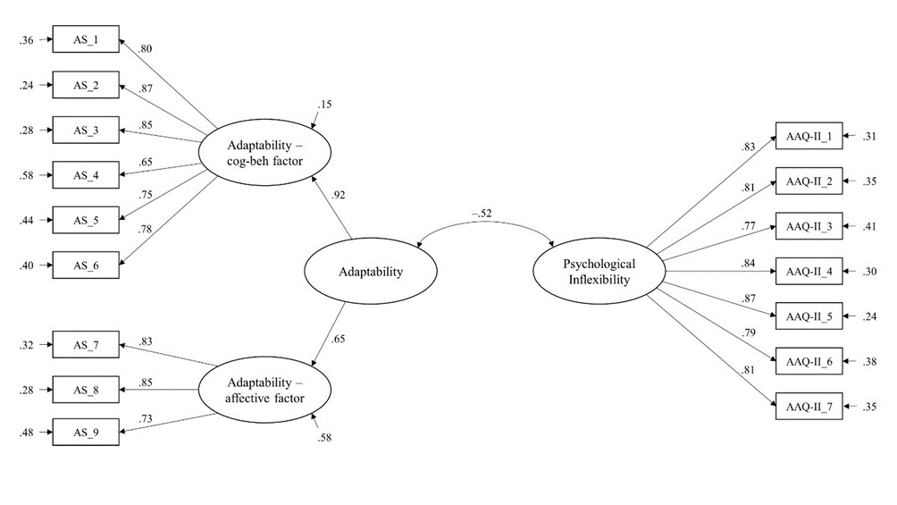
Confirmatory Factor Analysis

Slide 15
Structural Equation Model
Regression coefficients were all significant, except for the effect of adaptability on psychological distress.
Specifically, psychological inflexibility positively predicted psychological distress and negatively predicted well-being, and the magnitude of the former effect was significantly higher than the latter one, Δb = .14, S.E. = .07, p = .029.
Adaptability significantly and positively influenced well-being. Among the two outcomes, psychological distress showed the largest explained variance (R² = .62) followed by well-being (R² = .48).

Slide 16
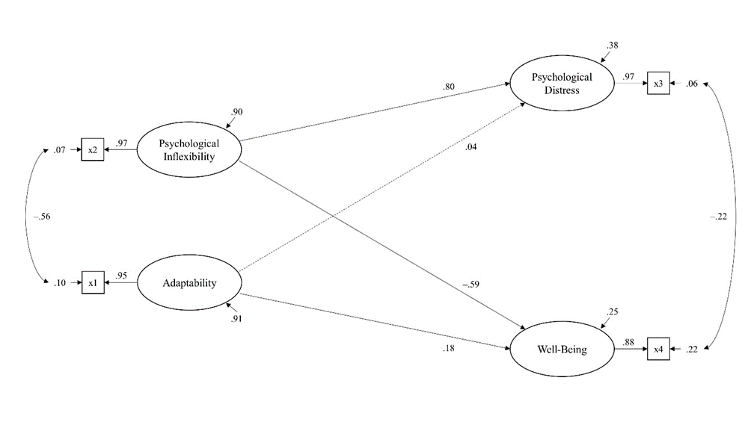
Structural Equation Model

Slide 17
Discussion
Results from the CFA suggest that there is an overlap between adaptability and psychological inflexibility but that the constructs are also sufficiently distinct.
Consistent with previous accounts, adaptability predicted psychological wellbeing (Hirschi, 2009; Martin et al., 2013; Zhou & Lin, 2016).
Similarly, psychological inflexibility was associated with reduced psychological wellbeing which replicates the effects noted in the empirical literature (e.g., Bond et al., 2011; Gillanders et al., 2014; Makrriyianis et al., 2019; Muris et al., 2017).

Slide 18
Discussion
The results from the SEM analysis indicated that adaptability was not a significant predictor of psychological distress after accounting for the effects of psychological inflexibility.
This might imply that effects pertaining to adaptability are more prevalent to wellbeing rather than distress.
However, there is limited research focusing on adaptability and psychological distress, thus further research is required to explore these effects further.
The stronger relationship observed between the AAQ-II and DASS-21 may be due to weak discriminant validity of the AAQ-II (e.g., Tyndall et al., 2018; Wolgast, 2014)

Slide 19
Limitations
All measures collected were self-report and poses the risk of potential biased responding
We took steps to screen out inattentive responders to help improve the reliability of the data.
All data was collected at one time point so limits the causal inferences that can be made between our variables.
However, this paper is focused on exploring an initial proof-of-concept, and as such we acknowledge that further research is required to extend and replicate these findings.

Slide 20
Future Directions
Researchers may consider exploring how a new novel dimension of psychological flexibility, ‘harnessing’ (Kashdan et al.,submitted) may influence the overlap between adaptability and psychological inflexibility.
Harnessing appears to reflect people’s ability to utilize particular forms of distress in particular challenging contexts as fuel to strengthen resolve and goal-related effort and progress.
Potentially investigate the links between curiosity and adaptability and psychological inflexibility.
Curious people tend to find interest in novel, complex, and uncertain events. If a person appraises that they can cope with psychological distress that is evoked by exploring the uncertain or novel event or situation, they remain curious. If they believe that they could not cope with the distress they will no longer be curious about the event (Silvia, 2008).

Slide 21
Conclusion
We found that adaptability and psychological inflexibility have considerable overlap, but can be considered unique constructs.
Preliminary evidence that adaptability is not a significant predictor of psychological distress after accounting for the effects of psychological inflexibility.
However, considering the recent debate about the construct validity of the AAQ-II, further examination is required to elucidate the predictive validity of psychological inflexibility in this context before any firm conclusions can be made.
This paper provides an initial proof-of-concept, which we hope that researchers will take forward to examine the mechanisms of adaptability and psychological inflexibility further.

